Slide 1


Detecting Fake News
with NLP
Rohan TANEJA
Johnny CHRIEM
Benjamin JACOBSEN
Fundamentals of NLP - 10 April 2025

Slide 2
Presentation content
Project overview
Dataset
Preprocessing steps
Model approaches
Best model
Streamlit app
Video Demo of Streamlit app
Challenges & Improvements
Learnings
Conclusion & Recommendations

Slide 3

Project overview
Objective
In todays world with the huge media influence, being able to detect the real information from the fake is very important. Our goal is to build a model that predicts if an article is real or fake, based only on text.
Applications:
Multiple approaches tested
Deployed a streamlit app as our prediction tool

Slide 4
Dataset
Name: fake_real_news.csv
268 rows
4 columns
Title
Text
IDD
Label
Cleaning
Removing non-english
Combining Title & text into one full
Removing Title, Text & IDD

Slide 5
Preprocessing
Tokenization
Remove stopwords
Remove characters except letters and whitespace
Stripping leading or trailing whitespaces
Lemmatization
Convert all words to lowercase
Remove punctuation

Slide 6
Approaches
BOW
LSTM
GLOVE
TRANSFER LEARNING - BERT

Slide 7
Build
Grid Search
Cross validation - Five fold
Hyperparameter tuning
BOW
Models | Test Accuracy | Test AUC
Logistic Regression | 0.93798 | 0.93796
SVM | 0.94015 | 0.94014
Naive Bayes | 0.91294 | 0.91294

Slide 8
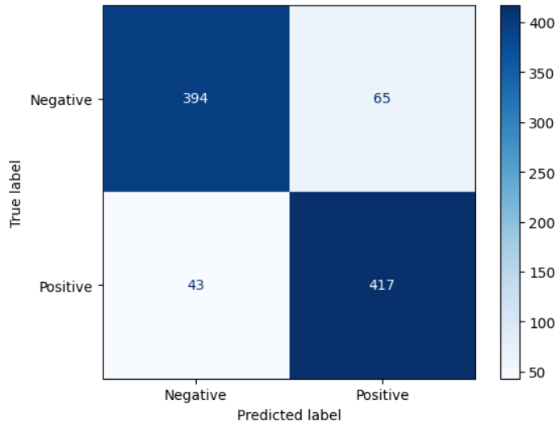
LSTM
Performance results
88.25% Test accuracy
Validation Accuracy: 89.32% after 4 epochs
Loss decreased significantly over epochs, showing effective learning
Build
Used up to 10.000 most frequent words
Padded sequences to 200 per article
Embedding layer (128 dimensions)
2 stacked LSTM layers (64 & 32 units)
2 Dropout layers (to reduce overfitting)
Dense layers for binary classification (with sigmoid output)
Early stopping, model checkpointing and learning rate reduction

Slide 9
GLOVE
Based on Stanford’s library
Standard data prep like others
pre-trained word embeddings 6b parameters
Accuracy of approximately 88% using a support vector classifier.

Slide 10
TRANSFER LEARNING
Transfer learning based on distilbert uncased from HuggingFace
3 epochs for 16 batch size
98.23% accuracy (our highest performing model so far)

Slide 11
TRANSFER LEARNING V2
Text classification based on multilingual-IPTC-news-topic-classifier from HuggingFace
Classifies news into 17 labels
Provides a distribution on how the percentage real and fake news vary in topics

Slide 12
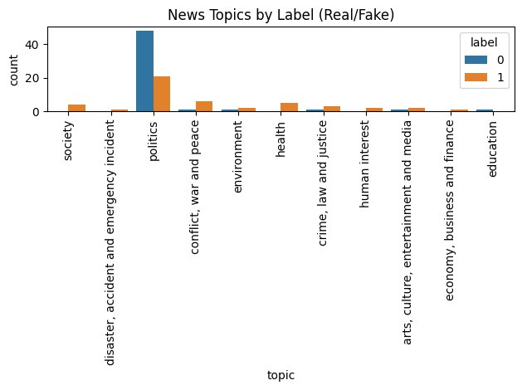

Slide 13
Best Model
BERT - Transferlearning
Pretrained model on distilbert uncased from HuggingFace
Accuracy of 98.23%
Used to develop the streamlit app

Slide 14
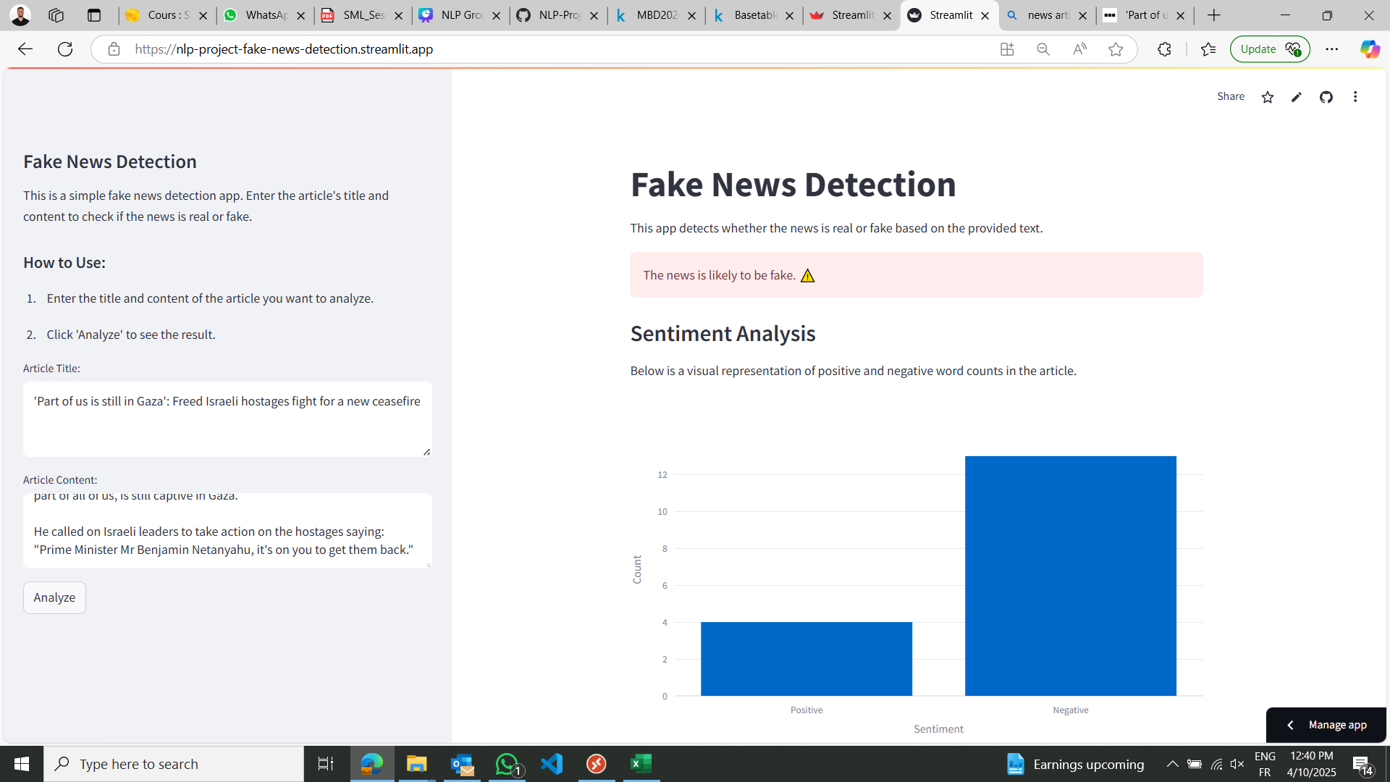
Click here to go to our streamlit app!
Streamlit APP
Click here to go to the Github repository
Insert the article title and content here to be used as in put for the model
Model deployment to classify if the news are real or fake
Sentiment Analysis of the input

Slide 15
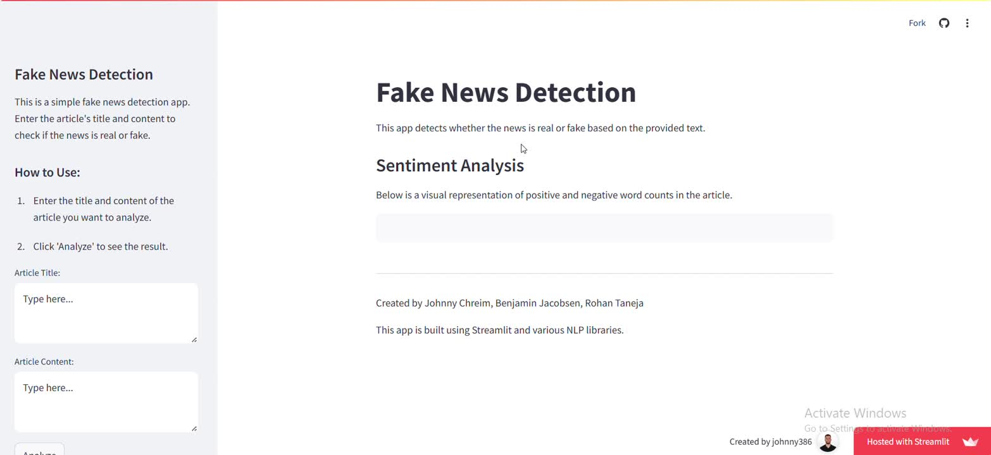
Video Demo

Slide 16


Challenges
Data primaily about politics
Model would genealize better on more topics
Specific data oriented model

Slide 17
Learnings
Key NLP techniques in practice
Text preprocessing - Tokenization, lemmatization, noise removal, language detection
Vectorization
TF - IDF
Word2vec
Model development and evaluation
Traditional machine learning (Logistic Regression, Random Forest)
Deep Learning (LSTM)
Fine tuning transformers (BERT)

Slide 18
Conclusion & Recommendations
Transfer Learning models performed the best for the problem
The data was limited, which led to a non generalized model
Streamlit app is a basic application, but it shows the importance of NLP applications
Training the model on a more general database would result in a better model, but would be heavy to collect all types of News articles

Slide 19


